Slide 1
Emergency
Illusions
Medical
Risk Assessment (PHAK 2-7)

Slide 2


Slide 3



Slide 4


Slide 5
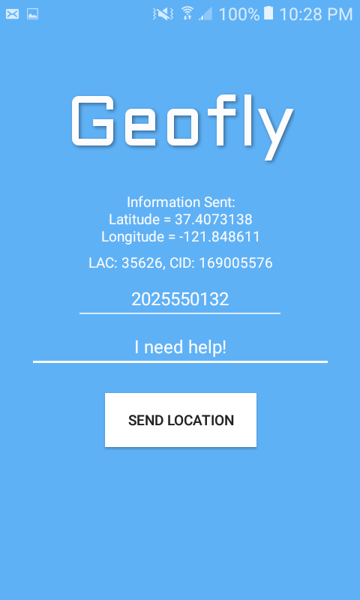
67.16159
-16.86248
44757
285439914

Slide 6
Java Classes
something.java
passengeremergencydrawer.java
Puts fragments in menu using id’s defined in something_drawer.xml
something.java
Puts fragments in menu using id’s defined in something_drawer.xml
FirstFragmentPassengerEmergency.java
Matches fragments to xml fragment layout files
Exception pilot_emergency_drawer.xml
drawer home page background
XML Files - Layout
content_something.xml
content_passengeremergencydrawer.xml
drawer home page background
activity_something.xml
activity_passengeremergencydrawer.xml
menu design
nav_header.xml
nav_header_ passengeremergencydrawer.xml
Just delete
Something_app_bar.xml
app_bar_ passengeremergencydrawer.xml
top bar color
first_layout.xml
first_layout_passengeremergency.xml
layout for first fragment
XML Files - Menu
something_drawer.xml
passengeremergencydrawer_drawer.xml
contains titles in menu and names their id’s
something.xml
passengeremergencydrawer.xml
hides the drawer settings tab

Slide 7
https://www.flyingmag.com/technique/proficiency/what-do-when-pilot-unconscious
Pilot emergency
Bird Strike
Clouds
Critical Control Failure
Decision-Making
Ditching
Door Open In-Flight
Electrical Failure
Electrical Fire
Engine Failure
Engine Fire
Field Landing
Hijacking
Icing
Illusions (hyperlink)
Instrument Malfunction
Landing Gear Failure
Laser Strike
Medical Conditions (hyperlink)
Mountainous Terrain
Night Emergency
Power Loss
Stressors
Volcanic Ash
Wake Turbulence
Passenger emergency
Ditching
Decision-Making
Depressurization
Emergency Exits
Forced Landing
Hijacking
Illusions (hyperlink)
Incapacitated Pilot
Medical Conditions (hyperlink)
Stressors
Turbulence
Wilderness Survival

Slide 8


